Slide 1
Presentation «Biography of Jean Monnet»
Prepared by a student of OR "Master", 1st year
Anya Dolishnya

Slide 2
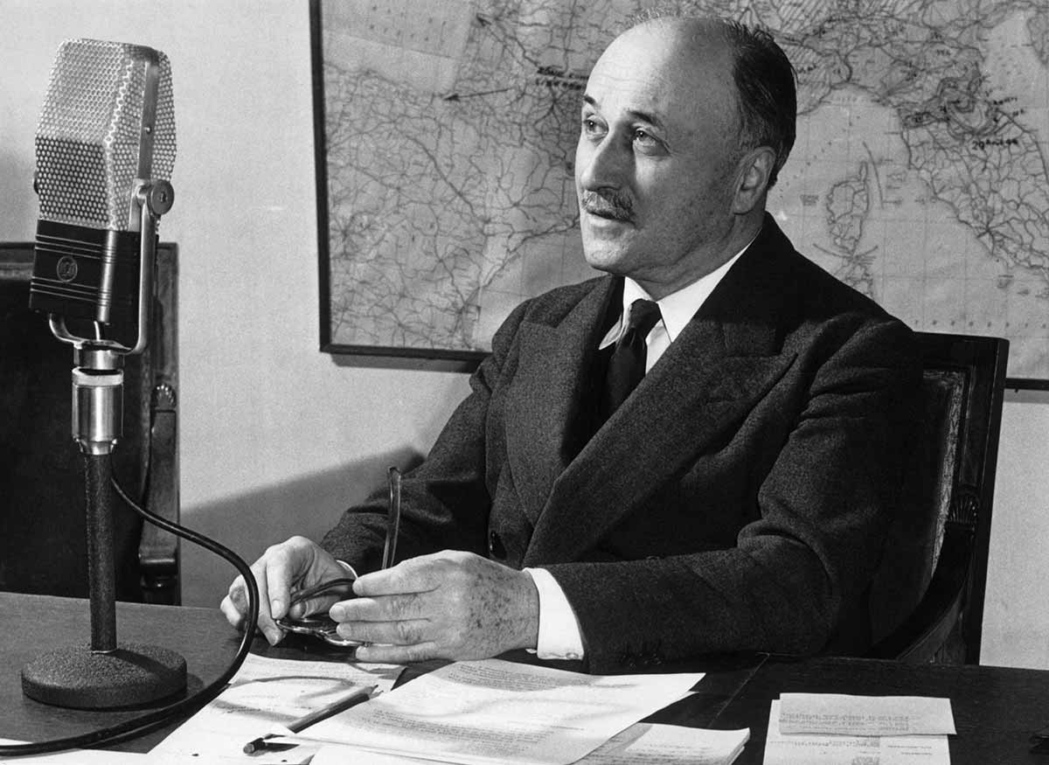
Early years of Jean Monnet.
Jean Monnet was born in the small town of Cognac (France) on November 9, 1888, into a family that traded in cognac.
Monet did not receive a secondary education and did not enter the university.
The father sent the young Monet abroad, where he worked for the benefit of the family business.

Slide 3
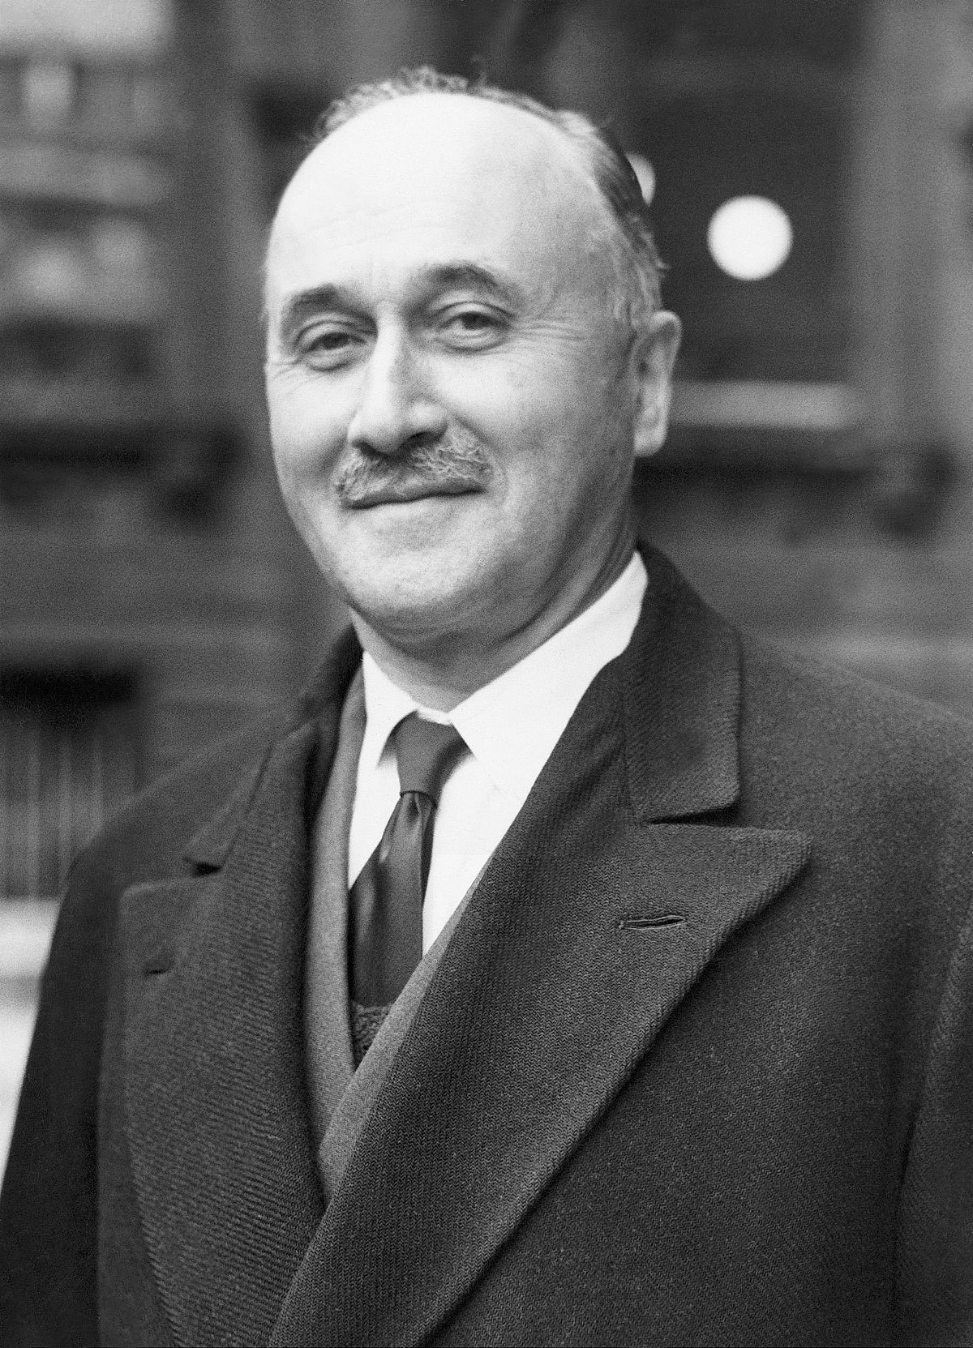
The period of the First and Second World Wars.
World War I broke out in 1914, but Jean Monnet did not serve in the army due to health reasons.
Monet worked at the Entente headquarters in London, and his activity was to make contacts between members of the Entente.
Monet was in favor of uniting Britain and France to win over Germany. He proposed a plan that was later approved, and this is what helped Monet gain credibility in the political arena of Europe.

Slide 4
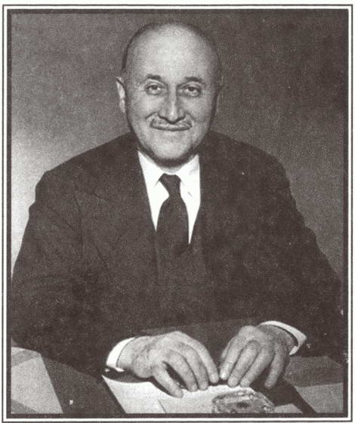
At the age of 31, he became Deputy Secretary General of the League of Nations.
Jean Monnet later worked as a French diplomat in Washington.
He later took a leadership position at the prestigious San Francisco Bank.

Slide 5
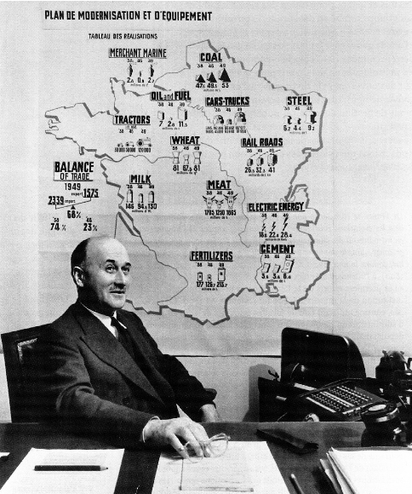
In 1938, Monet was a representative of the French government to negotiate the delivery of military aircraft from the United States.
In the following years he headed the Franco-British Economic Committee.
Monet proposed a plan to create an alliance between France and Britain. For this purpose, the idea of creating a constitution, parliament, government, as well as to introduce a single citizenship was expressed.

Slide 6
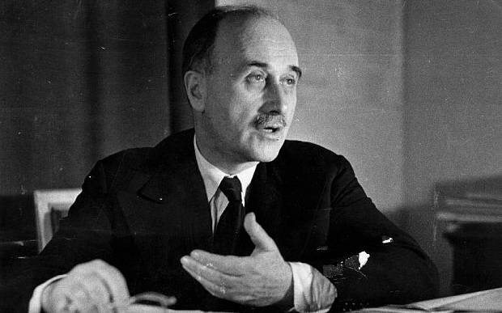
During World War II, Monet established friendly relations between Britain and the United States. For such active work, he became an adviser to President Roosevelt. The president listened to Monet's opinion and in 1941 began a program of victory, which was proposed by Monet and consisted of mass production of weapons to provide it to the Allies.
After the liberation of France, Jean Monnet worked on a plan for the development of the country and thanks to this the French economy was completely restored after the war.

Slide 7
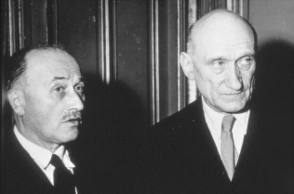
Establishment of the European Coal and Steel Community.
Jean Monnet and French Foreign Minister Robert Schuman put forward the idea of merging the German and French coal and steel industries, which were to be overseen by a specially created supranational body.
On May 9, 1950, on behalf of Chancellor, Monet, was able to make an official statement to the French government. He prepared a declaration outlining the idea of ​​uniting all Franco-German coal and steel production under a single leadership and allowing other countries to join the union freely.
Monet said: "This position is the first step towards a European federation and peacekeeping."

Slide 8
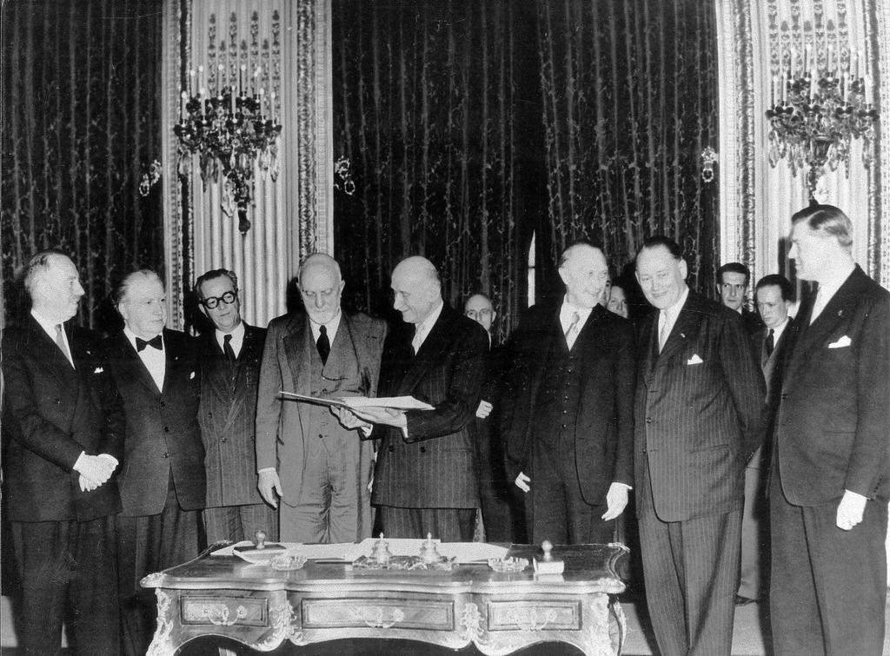
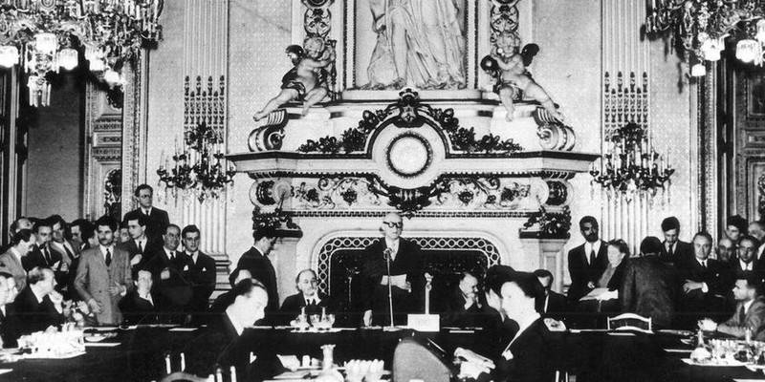
The Treaty establishing the European Coal and Steel Community was signed on 18 April 1951.
Subsequently, on August 10, 1952, the highest governing body began its work in Luxembourg and was headed by Jean Monnet.
It consisted of 8 members appointed for 6 years by mutual consent.
The ECSC was an independent legal entity. The Office consisted of the Supreme Governing Body, the European Parliament, the Special Council of Ministers and the Court.
In 1952, Jean Monnet became the first president of the ECSC.

Slide 9
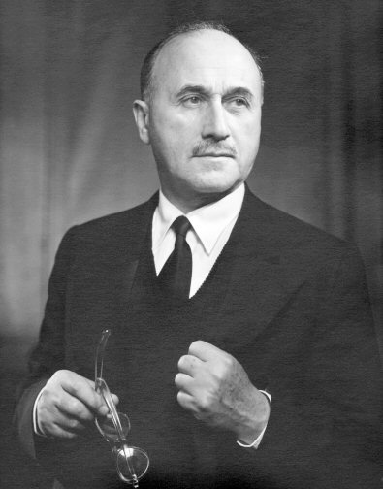
Monet proposed to the Prime Minister of France a defense plan, namely the creation of a "European army" under the joint command of Europe. The creation of such an army has to resist the forces of the USSR.
On August 30, 1954, the French National Assembly withdrew from the Treaty establishing the European Defense Union.
In 1955, Monet founded the Committee of the United States of Europe. This body is famous for its success.

Slide 10
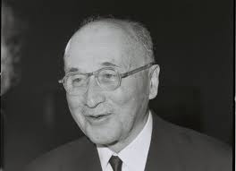
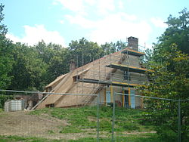
The last years of Jean Monnet's life.
In 1975, at the age of 87, Jean Monnet dissolved the Committee of Action for the United States of Europe.
Monet spent his last days at his home in Hujara writing memoirs.
At the end of 1976, a book of memoirs by Jean Monnet "Memoirs of a European" was published.
Jean Monnet died on March 16, 1979 at the respectable age of 91.

Slide 11
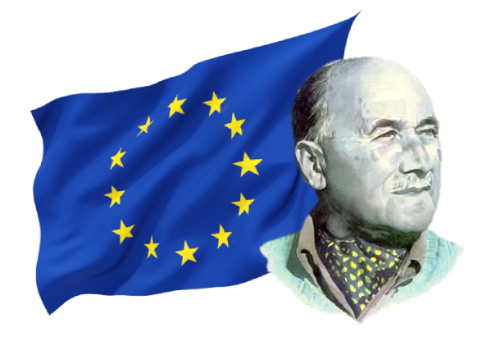
"Europe has never been - Europe still needs to be created«
J. Monnet

Slide 12
Thanks for your attention!

